Slide 1


BILL MANAGEMENTS
BY USING PYTHON
CREATED BY :- PAVAN KUMAR
12309132

Slide 2
Key Components
Introduction
Objective & Scope Of the Project
Application Tools
Project Design
Flowchart
Data Flow Diagrams
Usecase Diagram
Testing And Validation
Conclusion
References

Slide 3
Introduction
The Billing Software System manages multiple categories of products, such as cosmetics, groceries, and cold drinks, and can calculate the total cost based on customer selections. The system also handles customer information, such as name and phone number, and generates a unique bill number for each transaction . The application focuses on improving billing efficiency by automating calculations, reducing human error, and organizing transactions into a structured format. It includes key functionalities like total price calculation, tax application, bill generation, and customizable options for ease of use.
Key Features:
Category Totals: Automatically calculates the total cost for each product category.
Tax Inclusion: Adds applicable taxes (e.g., 5% on cosmetics and cold drinks, 10% on groceries) to the total.
Clear Button: Resets all fields and clears the "Bill Area."
Exit Button: Safely closes the application.
Cosmetics: Includes items like bath soap, shampoo, and body lotions.
Groceries: Includes essential goods like rice, sugar, and oil.
Cold Drinks: Covers beverages such as Coca-Cola and Frooti.

Slide 4
Objective of the project
The primary objective of this Billing Software Application project is to design and implement a user-friendly and efficient billing system that automates the process of generating customer bills for small to medium retail businesses.
Organize Product Categories
Enable easy selection and calculation of products across different categories like cosmetics, groceries, and cold drinks.
Support Scalability
Lay the groundwork for expanding the software in the future with features like inventory management, database integration, and advanced reporting.
Streamline the Billing Process
Reduce the time and effort required for manual calculations by automating the total cost and tax computation.

Slide 5
Scope of the Project:-
Customer Information Management:
Store customer details (name, phone number) and generate unique Bill numbers for each transaction.
Provide an option for retrieving previous bills by searching with a Bill number, allowing customers to track their past purchases.
Features and Usability
Multiple product categories to ensure flexibility in adding diverse items.
Options to reset inputs, search for previous bills, and exit the application conveniently.
Target Audience
Small to medium-sized retail businesses, shops, or individuals looking for a simple billing solution.

Slide 6
Application tools
. Integrated Development Environment (IDE)
VS Code: Lightweight and highly customizable, supporting extensions for Python development.
Testing and Debugging Tools:
Manual Testing: Conducting tests on GUI interactions and calculations to validate application behavior.
Libraries and Modules
os: For system-level operations like clearing the screen or managing files.
math: For any required mathematical operations in billing calculations.
datetime: To add date and time stamps on invoices.

Slide 7
Graphical User Interface (GUI): Tkinter
Tkinter is a built-in library for creating interactive desktop applications.
Features Provided:
Buttons, labels, text boxes, and drop-down menus.
Layout management for intuitive user interfaces.
Event handling for responsive applications
Documentation Tools
Markdown: Simplifies creating structured README files with headings, lists, and links.
Cost-Effective: Leveraging open-source tools minimizes development costs.
Ease of Learning: Python and its libraries are beginner-friendly, reducing development time.
Robust Functionality: The selected tools together provide all the features required for a comprehensive
billing solution.
Scalable: Tools like SQLite and Django ensure the application can evolve to meet future needs.

Slide 8
Project Design
System Architecture
The system follows a modular architecture that separates concerns and ensures maintainability. Key components include:
User Interface Layer
Built using Tkinter to provide an interactive desktop application.
Components include:
Input Fields: For entering product details like name, quantity, and price.
Buttons: For adding items, calculating totals, and generating invoices.
Display Area: To show the bill summary and total amount.
Data Storage Layer
Initially, data will be managed in memory using Python data structures (e.g., lists and dictionaries).
Future scalability includes integration with a database like SQLite for persistent storage of:
Product catalogs.
Transaction history.
Customer information.

Slide 9
Key Features
Dynamic Product Addition: Users can enter and add multiple products to the bill.
Tax and Discount Calculation: The application supports customizable tax rates and discounts, which can be applied to the overall bill or specific items.
Clear Product Details: Clear individual product details from the current bill if a mistake is made.
Transaction History: Store and retrieve previously generated invoices, allowing businesses to maintain a record of sales.
Customer Records: Future updates could include features to collect and store customer details, including names, addresses, and contact information.
Customer-Specific Billing: Allows creating bills with specific customer details, facilitating repeat customers and personalized billing.

Slide 10
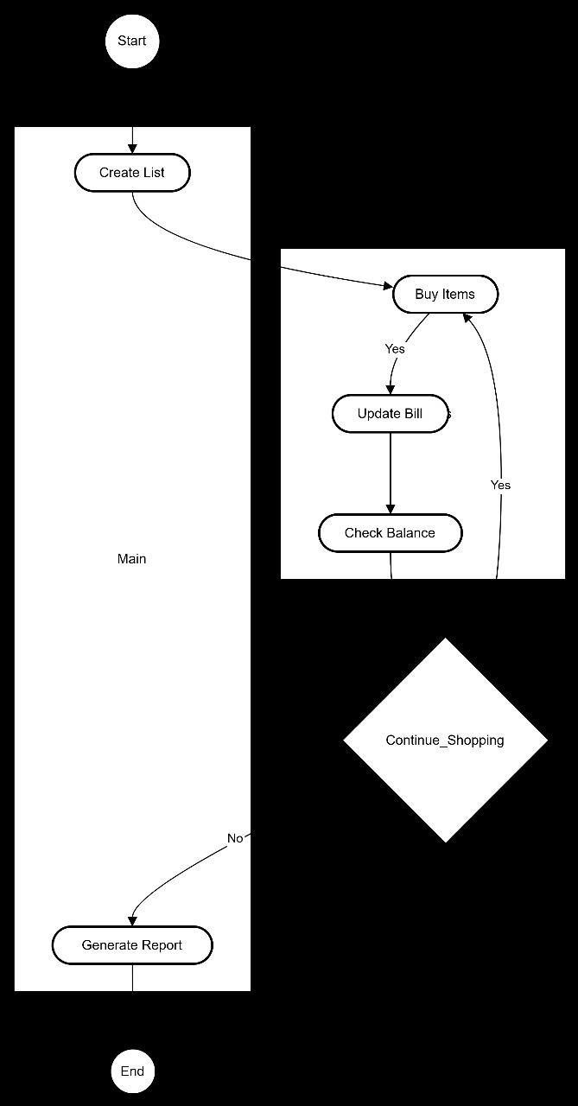
Flow chart

Slide 11
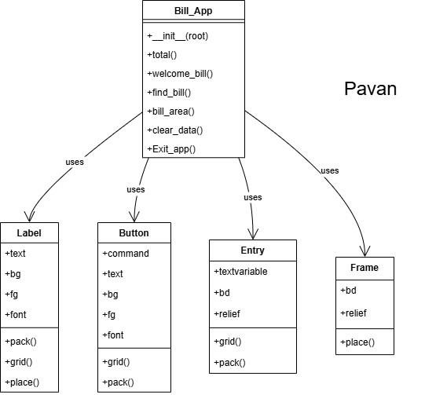
Data flow diagram

Slide 12
Testing and Validation
Ensure Functional Accuracy: Confirm that all features, such as billing, inventory management, and report generation, are working as expected.
Improve Usability: Verify that the GUI is user-friendly, intuitive, and provides a seamless experience.
Enhance Security: Ensure that sensitive data, such as user credentials and payment information, are protected.
Optimize Performance: Ensure that the system operates smoothly, even under high usage scenarios.
Verify Compatibility: Make sure the software works across different devices, operating systems, and browsers (if applicable).
Compliance with Requirements: Ensure that all project specifications and requirements are met, and the software adheres to legal and regulatory standards.

Slide 13
Conclusion
The development of the Billing Software Application aims to streamline and automate the billing process for businesses, providing an efficient, user-friendly solution for managing invoices, calculating taxes, applying discounts, and generating bills. Through careful planning and design, this application integrates all the core functionalities required for accurate and fast billing, while also addressing the needs for scalability, security, and usability.

Slide 14
Refrences
“Introduction to GUI Development.” W3Schools. Retrieved from https://www.w3schools.com.
"MySQL Database Documentation." MySQL 8.0 Reference Manual. Retrieved from https://dev.mysql.com.
"Android Development Guide." Android Developers. Retrieved from https://developer.android.com.
Online Documentation or Website
Microsoft. (2021, March 30). Introduction to C# Programming Language. Retrieved from:
https://docs.microsoft.com/en-us/dotnet/csharp/

Slide 15
Learning Outcomes
Understanding of Billing System Components
Gain a deep understanding of the core components of a billing system, including the user interface, database management, transaction processing, and invoice generation.
Skills in Database Design and Management
Develop the ability to integrate the database with the application backend to handle transactions and generate reports.
Problem-Solving and Analytical Thinking
Enhance problem-solving skills through the development of a billing system that addresses real-world issues such as payment processing, billing cycles, and data accuracy.
Apply analytical thinking to optimize the system for performance and scalability.
Knowledge of Software Testing and Debugging
Learn testing techniques for validating the functionality and usability of the system, including unit testing, integration testing, and user acceptance testing

Slide 16

This Photo by Unknown Author is licensed under CC BY-SA

